Slide 1
Carnegie Mellon University 15-415/615 Database Applications Spring 2015, C. Faloutsos & A. Paolo
HW7: Database Application
TAs: Hong Bin Shim, Vinay Bhat, Jiayu Liu, Elomar Souza

Slide 2
Overview
Design & implement a simple web application called ‘CMUPostly’
Today:
Application specs
Homework deliverables
Very brief intro to PHP
2
2

Slide 3
Data requirements
Users
Username (2-50 characters)
Password
Posts
Has title and body text
Have to record when they were posted
Posts can be “liked” by users
3
3

Slide 4
Functionality requirements
Create user account
Reset database
Login
Timeline
List of hottest posts
Add a post
Search for a user by username
Like a post
Delete a post
4
4

Slide 5
Functionality requirements
Recommend posts based on likes
For user U recommend posts that are “liked” by like-minded users.
Like-minded users of U are users who “like” what U likes.
Rank them according to how many common likes a post has
Don’t include posts that U already likes
5
5

Slide 6
User recommendation example
user 1
post 1
Recommend posts to user1
user 2, user 3, user 5 like
what user 1 likes
user 2: post 3
user 5: post 3, post 5
*Note that it doesn’t include
posts user 1 already likes
sort by # likes for each post
=> recommend post 3, post 5
user 2
post 2
user 3
post 3
user 4
post 4
user 5
post 5
6
6

Slide 7
Functionality requirements
List all posts for a given user
Search for posts
User statistics
# posts by the user
# likes by the user
Global statistics
List of K most posts with most likes
List of K most active users
7
7

Slide 8
Example web application
http://www.contrib.andrew.cmu.edu/~hongbins/cmupostly/
8
8

Slide 9
Homework Specifics
Follow the design methodology from Lecture 19
Organized in 2 Phases
Phase 1 – Design: due 3/31
Phase 2 – Implementation: due 4/14
9
9

Slide 10
Phase 1
You are free to come up with your own design choices as long as
they follow the methodology
they are reasonable
you are able to justify unconventional choices
10
10

Slide 11
Phase-I
Phase-II
description
conc. mod.
impl.+test.
req. anal.
code.
tests
top level I.F.D.
schema.
user’s man.
sys. anal.
task emul.
task + doc forms.
pseudo-code
11

Slide 12
Top level information flow diagram
registration form
external document
(web forms)
T1-reg.
tasks
internal document
(database tables)
user record
System boundary
12

Slide 13
Phase-I
Phase-II
description
conc. mod.
impl.+test.
req. anal.
code.
tests
top level I.F.D.
schema.
user’s man.
sys. anal.
task emul.
task + doc forms.
pseudo-code
13

Slide 14
Document + Task forms
Task forms and task list
not required for this homework
Document forms and document list
D1: registration form
D2: login form
D3: timeline form
…
Dx: user record
…
external
internal
14

Slide 15
Document forms
D1: registration form
username
Password
Dx: user record
username
Password
15

Slide 16
Phase-I
Phase-II
description
conc. mod.
impl.+test.
req. anal.
code.
tests
top level I.F.D.
schema.
user’s man.
sys. anal.
task emul.
task + doc forms.
pseudo-code
16

Slide 17
E-R diagram
Specify cardinalities
Think about weak/strong entities
Justify unconventional choices
17

Slide 18
Relational schema
Give the definition of the schema
Give SQL DDL statements including constraints.
18

Slide 19
Phase-I
Phase-II
description
conc. mod.
impl.+test.
req. anal.
code.
tests
top level I.F.D.
schema.
user’s man.
sys. anal.
task emul.
task + doc forms.
pseudo-code
19

Slide 20
Task emulation/pseudo-code
No need to write pseudocode
Simply give all SQL DML statements for all tasks
20

Slide 21
Phase 1: What to hand-in
Due 3/31
Hard copy (in class)
Electronic copy (Blackboard)
21
21

Slide 22
Phase-I
Phase-II
description
conc. mod.
impl.+test.
req. anal.
code.
tests
top level I.F.D.
schema.
user’s man.
sys. anal.
task emul.
task + doc forms.
pseudo-code
22

Slide 23
Phase 2
We provide an API in PHP
Implements the web site functionality
Has empty calls to the database
write PHP code that
wraps the SQL statements
returns the output to the rest of the given code (PHP arrays)
No need to provide user manual
23
23

Slide 24
Phase 2
Unzip hw7.zip
You need to edit 2 files
config.php
add your login & url info
functions.php
Contains empty definitions of the functions that you have to implement
24
24

Slide 25
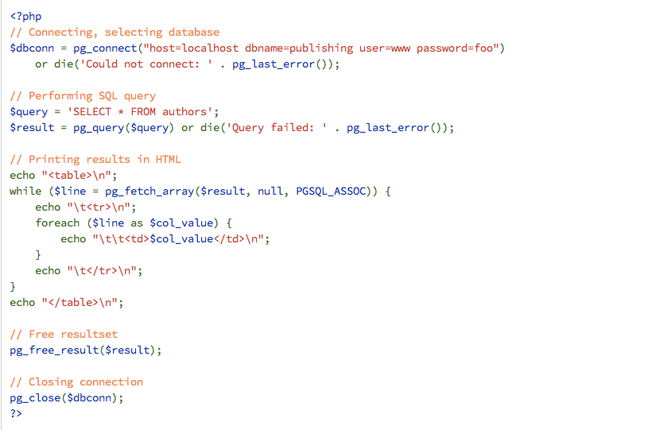
PHP & Postgres
Start connection
Issue query & read
results
See more at: http://www.php.net/manual/en/book.pgsql.php
25
25

Slide 26
PHP arrays
Array creation:
Bulk insertion (like stack):
See more at: http://www.php.net/manual/en/language.types.array.php
26
26

Slide 27
Securing your application
SQL injection
Set name equal to
The SQL statement that gets executed is
Results in un-authorized log-in!!!!
Your code has to account for that
Hint: pg_escape_string()
27
27

Slide 28
Phase 2: What to hand-in
Due 4/14
Website (IMPORTANT): See hw7.pdf for details
Hard copy (in class): ONLY new/changed code (save the trees ☺ )
Electronic copy: A .zip with all the code
28
28

Slide 29
Homework 7: Architecture
CMU Contributed Web Server
Any host
Web Server
Client
Browser
PostgreSQL
Database Server
Apache
http
cmuPostly Web app
PHP
hw7
database
CMU AFS
andrew_id/www

Slide 30
Access to web server
You will use the Computer Club Contributed Web Server
Apache server + Postgres DB server
Publishes *.php code in your AFS ‘www’ directory
More details
http://www.club.cc.cmu.edu/doc/contribweb.php
HW7 description (read carefully)
30
30

Slide 31
Publishing your web app
Please do the following ASAP and let us know if it doesn’t work!
Sign up for the web server here http://my.contrib.andrew.cmu.edu
Create DB user account here http://www.club.cc.cmu.edu/doc/contribweb/sql.php
Unzip hw7.zip and copy contents on folder ‘cmupostly’ under your AFS www directory
Edit config.php with your own db+server parameters
Edit folder content permissions: chmod +rx
Go to http://www.contrib.andrew.cmu.edu/~andrew_id/cmupostly
31
31

Slide 32
Questions?
Come to office hours (4 TAs + 2 instructors)
Post your questions on blackboard.
33
33

